Slide 1



AtliQ Mart
SUPPLY CHAIN PROJECT
Retail & FMCG Sector
Presented by : Sachin Savkare
This project was developed as part of the Microsoft Fabric Mini Data Analytics Bootcamp conducted by Codebasics.

Slide 2
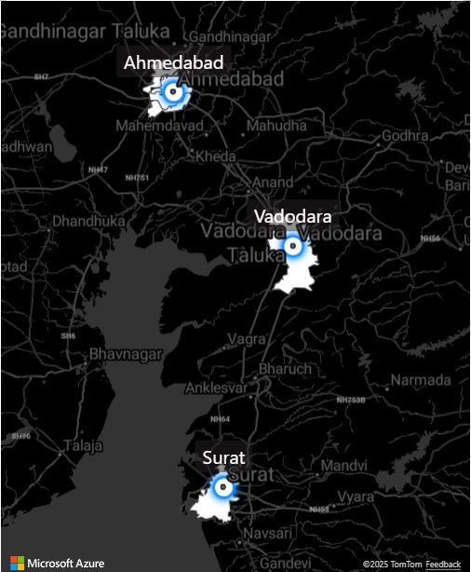
About AtliQ Mart & Problem Statement
AtliQ Mart, FMCG Manufacturer (Gujarat, India)
AtliQ Mart is a fast-growing FMCG company operating in Surat, Ahmedabad, and Vadodara, aiming to expand to other Tier 1 cities in the next 2 years. However, several key clients have not renewed their annual contracts due to persistent service-level failures.
Stakeholders believe that the cause may be:
Delayed deliveries
Incomplete order fulfilment
To resolve this, the supply chain team decided to measure:
On-Time Delivery (OT%)
In-Full Delivery (IF%)
On-Time In-Full (OTIF%)
These KPIs will help monitor customer order service levels daily and enable fast resolution to avoid contract loss and support business growth.
SUPPLY CHAIN PROJECT

Slide 3
Role : Data Analyst
Data analyst : Supply chain analytics team
Build key performance metrics.
Design an interactive dashboard using Microsoft Fabric.
Extract additional business insights beyond stakeholder requirements.
Help identify the root causes of service failures through data analysis.
SUPPLY CHAIN PROJECT

Slide 4
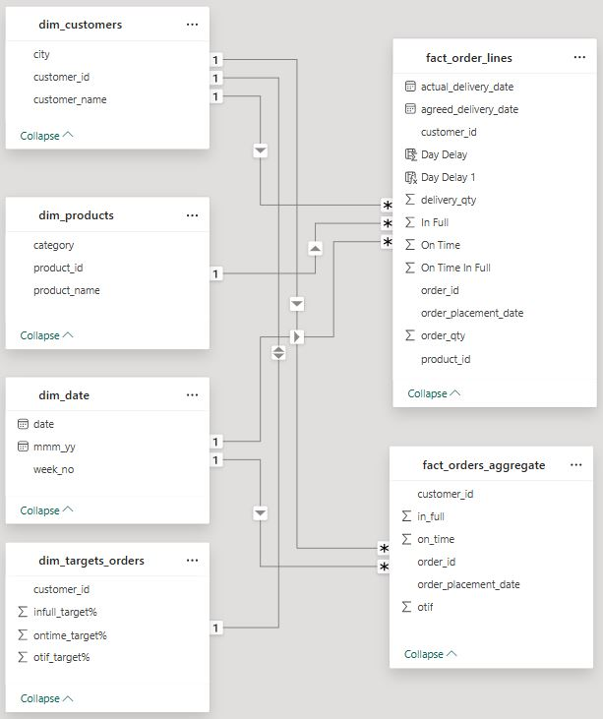
Data Modelling and Measures
Microsoft Fabric Mini : Dataflow : Power BI : Power Query : Lakehouse (Data Storage)
3PL Database
My SQL Database
Raw Data Storage
(Lakehouse_Raw-Files_AtliQ_Mart
SUPPLY CHAIN PROJECT
Transformed Data Storage
(Lakehouse_AtliQ_Mart_Transformed-data)
Transformation
(Data Flow _AtliQ_Mart_Data
Power BI Desktop
(AtliQ_Mart_Supply_Chain_Analytics)
Power BI Service
(Publish Project Online)

Slide 5
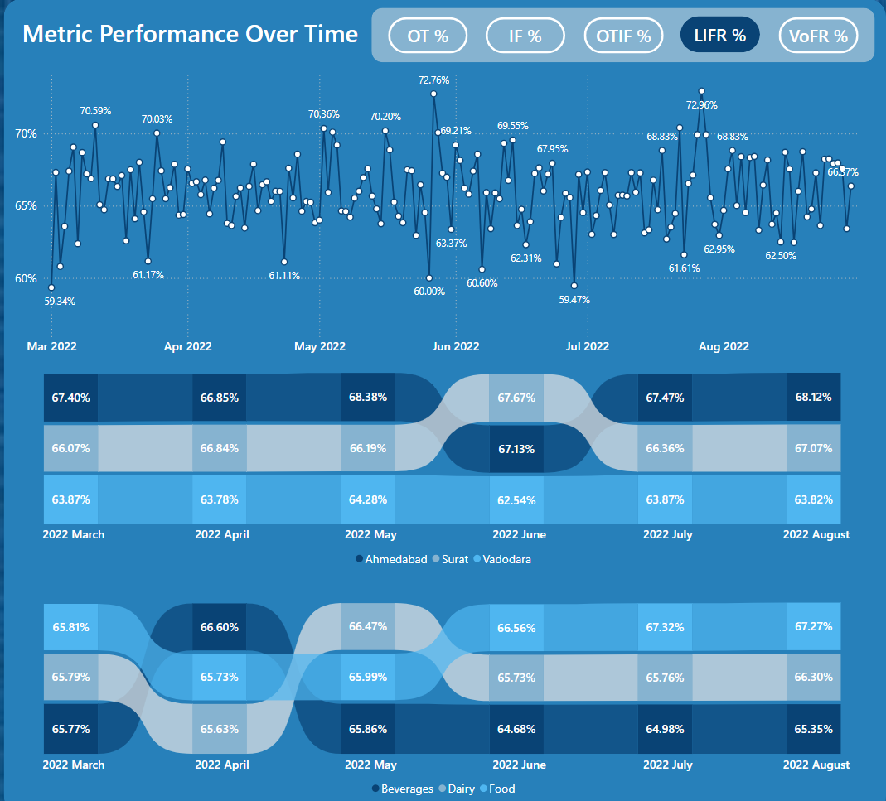
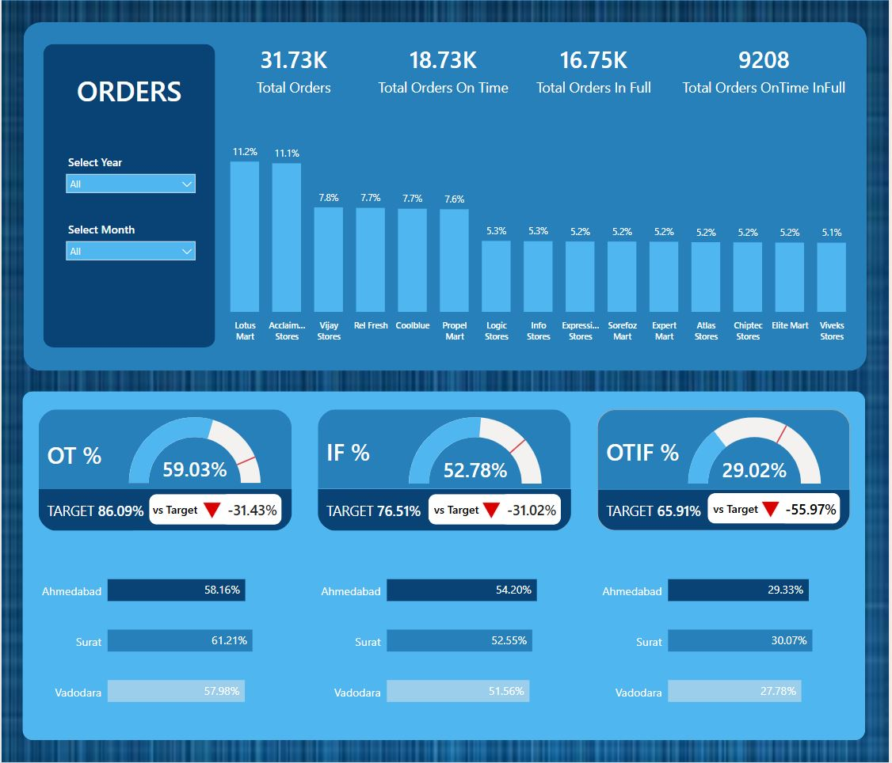
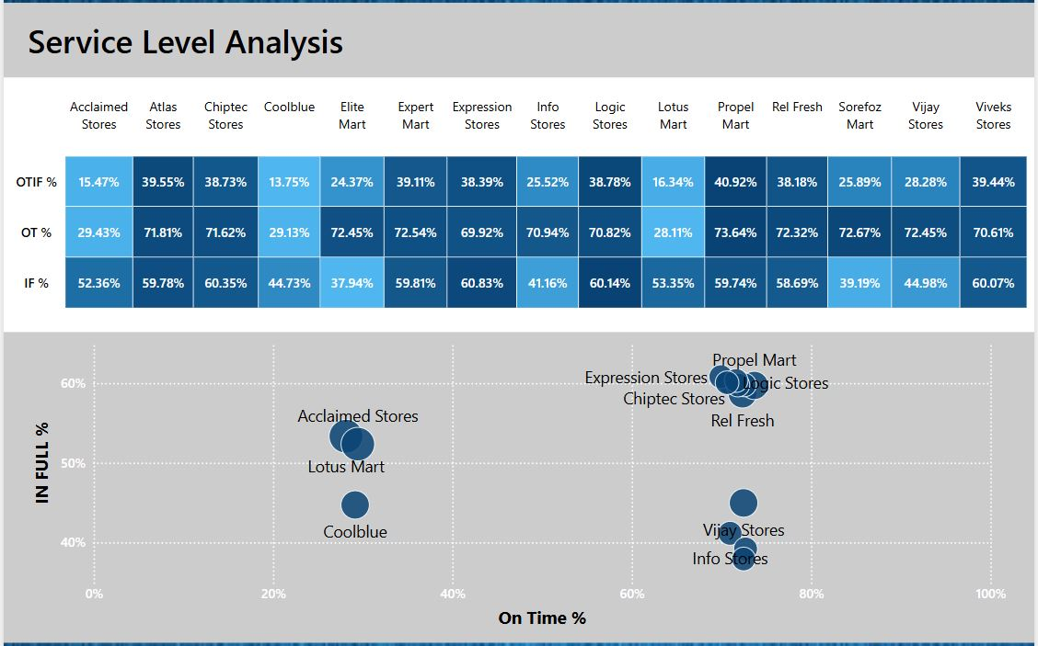
AtliQ Mart Supply Chain Dashboard
Power BI Service : Views
Orders
Service Level Analysis
Metric Performance Over Time
Order Lines
Line Lead Time Analysis
Products
SUPPLY CHAIN PROJECT

Slide 6
Store-Wise Performance (Top % of Total Orders)
Lotus Mart (11.2%) and Acclaim Stores (11.1%) contribute the most to order volume.
Long tail of stores contributes under 8% each; potential for demand consolidation or store prioritization.
ORDERS
Key Metrics Observed:
Total Orders: 31.73K
On-Time Orders: 18.73K
In-Full Orders: 16.75K
On-Time In-Full Orders (OTIF): 9208
City Level Breakdown (Ahmedabad, Surat, Vadodara)
OT %:
Surat performs best (61.21%)
Vadodara lowest (57.98%)
IF %:
Ahmedabad highest (54.20%)
Vadodara lowest (51.56%)
OTIF %:
Surat highest (30.07%)
Vadodara lowest (27.78%)
Metric | Current | Target | Deviation
OT % (On Time) | 59.03% | 86.09% | ▼ -31.43%
IF % (In Full) | 52.78% | 76.51% | ▼ -31.02%
OTIF % | 29.02% | 65.91% | ▼ -55.97%

Slide 7
Recommendations
1. Deep Dive Into Top Volume Stores
Audit Lotus Mart & Acclaim Stores' order processing timelines.
Prioritize performance reviews in these outlets.
2. Launch Targeted OTIF Improvement Program in Vadodara
Investigate vendor, warehouse, and delivery Service Level Agreement (Service Provide and Customer) in this city.
Possibly restructure routes or buffer inventory.
3. Establish City-Level Weekly Monitoring
Create mini dashboards per city → drill into delay causes (e.g., dispatch delay, stockout, transit).
4. Focus on Root-Cause Segmentation
Break down OT and IF issues by:
Product category
Vendor/supplier
Logistics partner
Insight Summary
1. OTIF Performance Is Critically Low (29.02%)
Falling far short of the 65.91% target.
Root cause likely due to breakdowns in either timely dispatch or stock fulfilment.
Both OT% and IF% are significantly under target, contributing to this.
2. Supply Chain Efficiency Varies Across Cities
Surat consistently outperforms in all KPIs.
Vadodara lags behind in every metric an immediate area of concern.
3. High Order Volume Stores May Be Driving Failures
Lotus Mart & Acclaim Stores contribute ~22% of total orders.
If performance here is below par, it drags the entire OTIF score down.

Slide 8
Unbalanced Stores
Elite Mart: Good OT (72.45%) but very low IF (37.94%) → frequent stockouts or packaging issues
Vijay Stores: Very good OT (72.45%) but low IF (44.98%) → fulfilment reliability issue
Insight: These require process-specific interventions, not general strategies.
Service Level Analysis : Observations & Insights:
Top Performing Stores (Above Average in All Metrics)
Store | OTIF % | OT % | IF %
Propel Mart | 40.92% | 73.64% | 59.74%
Atlas Stores | 39.55% | 71.81% | 59.78%
Chiptec Stores | 38.73% | 71.62% | 60.35%
Logic Stores | 38.78% | 70.82% | 60.14%
1. Only 4-5 stores are close to OTIF target
All others fall 10%–50% below the target.
Need to replicate processes from top performers like Propel Mart and Logic Stores.
Insight: These stores are performing closest to the OTIF target (65.91%) and are ideal benchmarks for others.
Low Performers: Major OTIF Risk
Store | OTIF % | OT % | IF %
Coolblue | 13.75% | 29.13% | 44.73%
Lotus Mart | 16.34% | 28.11% | 53.35%
Acclaimed Stores | 15.47% | 29.43% | 52.36%
2. Scatter Plot Shows Two Distinct Clusters:
Top Right = Balanced OT & IF (best practice zone)
Bottom Left = Poor on both (needs urgent improvement)
Insight: These stores are severely underperforming in both OT and IF, pulling down the average OTIF across the business.

Slide 9
Recommendations
3. Review Elite Mart & Vijay Stores for Fulfilment Weakness
Despite good delivery timeliness, fulfilment is poor.
This could point to system-level planning or warehouse stock issues.
1. Benchmark from Top Performers
Create SOPs from Propel Mart/Chiptec processes
Understand how they manage inventory accuracy, dispatch coordination, and delivery
Possible Solutions:
Warehouse Replenishment Buffers for low IF stores
Introduce SKU (Stock Keeping Unit)-level stock alerts
Use AI-driven delivery routing for last-mile improvement
Pilot incentive models for store managers based on OTIF improvement
2. Segment Store Action Plans
Cluster | Action
High OT, Low IF | Improve fulfilment (add safety stock, review suppliers)
Low OT, High IF | Focus on logistics (reroute, delivery windows)
Low OT & IF (e.g., Coolblue) | End-to-end audit (supplier → warehouse → last mile)

Slide 10
Metric Performance Over Time
OT % (On-Time %)
Key Insights:
Target OT % = 86.09%; performance remains 15–25% below target, with fluctuating trends between 54–67%.
May and August saw minor highs (67.63%, 64.60%) but are not sustained.
Surat is relatively consistent; Ahmedabad shows high variance.
Recommendations:
Conduct root cause analysis for delays.
Introduce predictive analytics to forecast delays and reroute dispatches.
2. IF % (In-Full %)
Key Insights:
Performance is significantly below the OT target of 76.51%, with values mostly between 44% to 60%.
Occasional spikes in June (65.38%) and August (60.11%) suggest temporary improvements.
Surat showed the most stability; Ahmedabad had wider fluctuations.
Recommendations:
Prioritize process standardization in Ahmedabad.
Investigate supply chain constraints leading to partial order fulfilment.

Slide 11
Metric Performance Over Time
OTIF % (On-Time In-Full %)
Key Insights:
Overall OTIF performance remains weak, hovering around 25–35%, far from a healthy benchmark (~65.91%).
June saw a small spike to 37.42%, followed by a drop again.
Significant regional consistency, but at low levels.
Recommendations:
Need a combined intervention on both OT and IF metrics.
Create a cross-functional task force to focus on OTIF as a strategic KPI.
LIFR % (Line Item Fill Rate)
Key Insights:
Stable performance around 65–70%, but still below ideal benchmarks.
Surat outperforms Ahmedabad consistently; June saw a notable dip to 59.47%.
August showed slight recovery to 66.67%.
Recommendations:
Explore line-level inventory or system mismatch issues in June.
Replicate Surat’s operational practices across other zones.

Slide 12
Metric Performance Over Time
Cross-Metric Observations:
VoFR % (Volume Fill Rate)
Key Insights:
VoFR shows exceptional stability, maintaining >95.5% to 97.3% throughout all months.
Surat and Food Category lead consistently.
Even during other metric drops (like OTIF/IF), VoFR remained strong, indicating volume commitments are met.
Recommendations:
Use this VoFR process as a best-practice model.
Shift some operational emphasis toward improving item-level and timing precision, since volume accuracy is already high.
KPI | Strength | Weakness | Opportunity
IF % | Mid-50s baseline | Doesn't reach 76% OT target | Focus on zone-level partial fills
OT % | Minor peaks | Below target by ~20% | Predictive delay alerts
OTIF % | Consistent trend | Low overall (30% avg) | Joint OT and IF interventions
LIFR % | ~67% baseline | Dips in mid-year (June) | Line-item inventory improvement
VoFR % | Consistently >95% | Minor variation | Use as process benchmark
The core issue across visuals is timing and item-level accuracy, while volume commitments are reliably met.
Surat consistently performs better, making it a potential benchmark location for cross-training and SOP deployment.
Recommend focusing on OTIF % as the North Star Metric, backed by predictive dispatching, better vendor SLAs, and warehouse efficiencies.

Slide 13
Order Lines vs LIFR % (Mar 2022 – Aug 2022)
Summary Metrics (Mar–Aug 2022):
Total Order Lines: 57.10K
Fully Filled Order Lines: 37.66K
LIFR % (Line Item Fill Rate): 65.96%
VOFR % (Volume Order Fill Rate): 96.59%
Key Observations:
Low LIFR Despite High Volume:
Vijay Stores (5.0K, 59%) and Acclaim Stores (4.8K, 59%) processed high order volumes but had poor line fulfilment.
These stores may face product availability or picking inefficiencies.
Top Performing Stores (LIFR %):
Propel Mart (76%) and Chiptec Stores (76%) lead in order line fulfilment efficiency.
Rel Fresh, Expert Mart, Viveks Stores also performed well with LIFR ≥ 75%.
Lowest Performing Store:
Coolblue (52%) had the weakest LIFR, indicating severe fulfilment gaps.
Elite Mart, Sorefoz Mart, Info Stores each hover around 53%, showing recurring inefficiency.
Strategic Insights :
While Volume Fill Rate (VOFR) is strong at 96.59%, the relatively low LIFR of 65.96% shows that many orders are not fully filled at the line-item level. High-volume but low-LIFR stores like Vijay and Acclaim require targeted improvements in order fulfilment practices.
Replicating the operational models of Propel and Chiptec Stores could help standardize efficiency across all locations.

Slide 14
Line Lead Time Analysis
1: Category-wise Lead Time Performance
3: Store-wise LIFR % and Timeliness (Based on Delivery Types)
Day Delay | Dairy | Food | Beverages | Total | % Share
0 (On Time) | 24,521 | 6,306 | 6,171 | 36,998 | 65%
1–3 Days Delay | 11,124 | 2,664 | 2,706 | 16,494 | 29%
Early (-1 Day) | 2,454 | 569 | 584 | 3,607 | 6%
Store | LIFR % | On Time % | Delay % | Key Insight
Coolblue | 51.53% | 4.28% | 1.16% | Lowest LIFR with excessive early deliveries logistics misalignment.
Sorefoz Mart | 53.40% | 0.87% | 0.37% | Weak planning and dispatch.
Elite Mart | 53% | 0.88% | 0.35% | Needs route and stock review.
Vijay Stores | 59.23% | 0.94% | 0.54% | Slight improvement, but still below benchmark.
Propel Mart | 75.62% | 1.22% | 0.53% | Top performer, replicate model.
Atlas, Chiptec, Viveks, Rel Fresh | ~75% | ~0.9% | ~0.35% | Highly consistent and balanced stores.
Insight:
Dairy dominates order volume and performs best in on-time delivery.
Food and Beverages have lower volumes, with slightly higher early/late deliveries.
2: Location-wise Lead Time Performance
Day Delay | Ahmedabad | Surat | Vadodara | Total | % Share
0 (On Time) | 12,531 | 12,050 | 12,417 | 36,998 | 65%
1–3 Days Delay | 5,902 | 4,698 | 5,320 | 15,920 | 28%
Early (-1 Day) | 1,243 | 1,094 | 1,270 | 3,607 | 6%
Insight:
All three cities (Ahmedabad, Surat, Vadodara) show uniform behaviour with 65% on-time delivery.
Ahmedabad has the highest total order count and performs slightly better in early deliveries.

Slide 15
Recommendations
Fix Logistics in Coolblue & Elite Mart
Review lead time settings and dispatch rules; minimize early deliveries.
Improve Fulfilment Consistency
Push all low-LIFR stores (>5% gap) toward 70–75% benchmark through operational standardization.
Share Best Practices
Learn from Propel Mart, Chiptec, and Atlas. Clone inventory policies and delivery SOPs across struggling stores.
Monitor Category-wise Delays
Dairy is efficient; however, more attention is needed in Beverages (more early dispatches) and Food (slightly delayed deliveries).

Slide 16
Product Performance
1. Food
Strength: AM Biscuits 750 shows a VOFR% of 96.85%, reflecting strong vendor reliability.
Gap: AM Biscuits 250 has a LIFR% of 65.16%, despite high supplier performance implying an internal execution gap.
Action: Review demand forecasting accuracy and shelf replenishment cycles.
3. Beverages
Balanced Metrics: VOFR% stable above 96%, LIFR% tightly grouped near 66%.
Best Performer: AM Tea 500 with a 66.14% LIFR and 96.52% VOFR indicates the best SKU alignment.
Quick Win: Small interventions in inventory placement and route planning could raise fulfilment.
2. Dairy
Consistent Supplier Performance: VOFR% across all SKUs is above 96%, indicating vendors are not the bottleneck.
Execution Weakness: LIFR% remains between 63–67%, the lowest among all categories.
Recommendation: Explore root causes—cold chain logistics, store-level stockouts, or inefficient product rotation.
Strategic Recommendations
Communicate Confidence: Emphasize high VOFR% to assure stakeholders of vendor strength.
Prioritize Internal Optimization: LIFR% drag suggests issues post-receipt revisit inventory distribution, in-store execution, and forecasting.
Dashboard Opportunity: Introduce a visual tracker highlighting SKU-level VOFR–LIFR gaps for proactive intervention.

Slide 17
THANK YOU

Slide 18
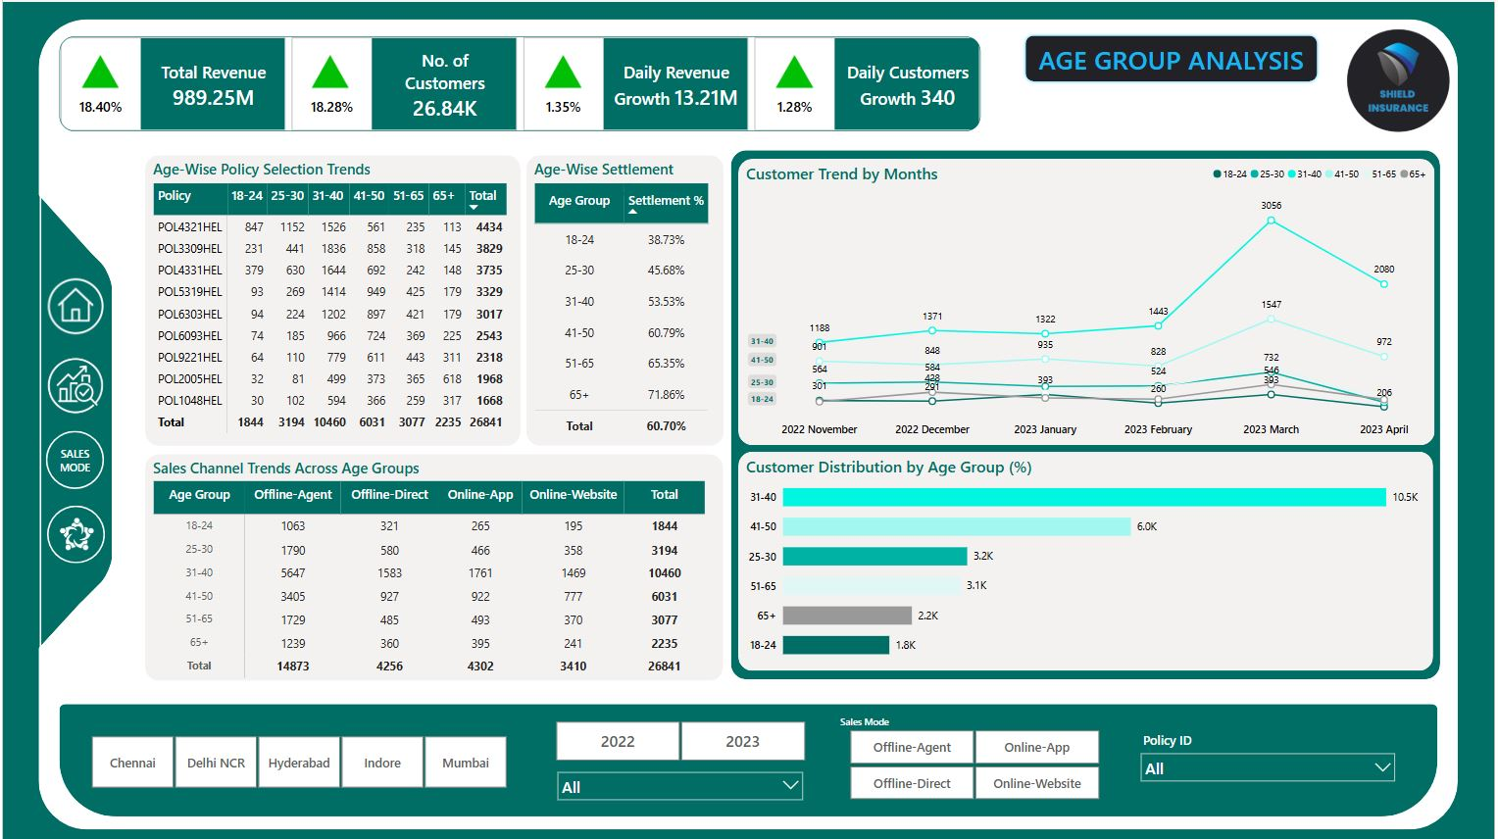
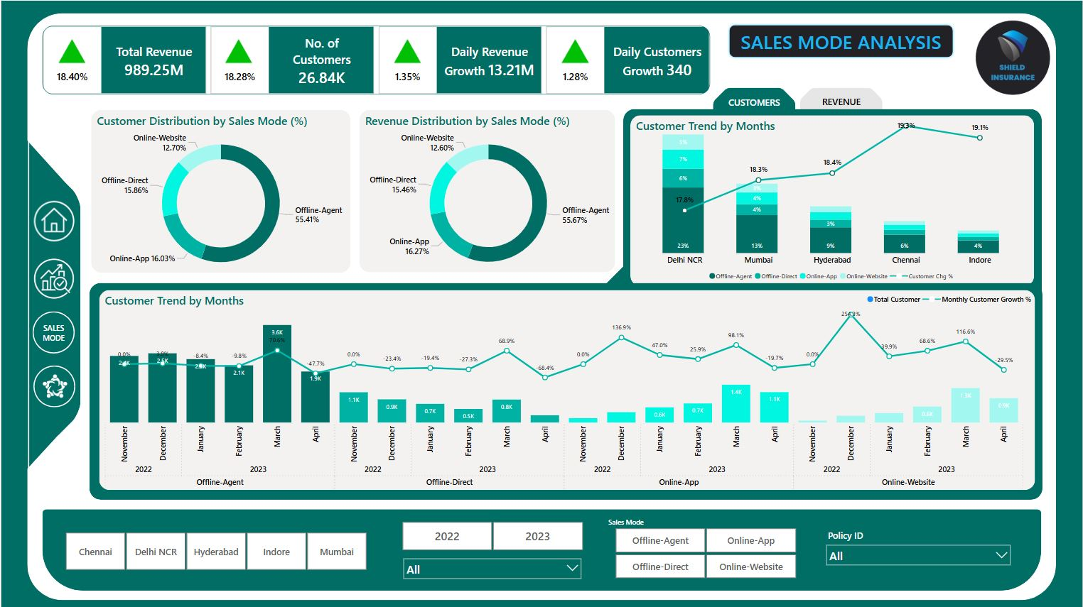
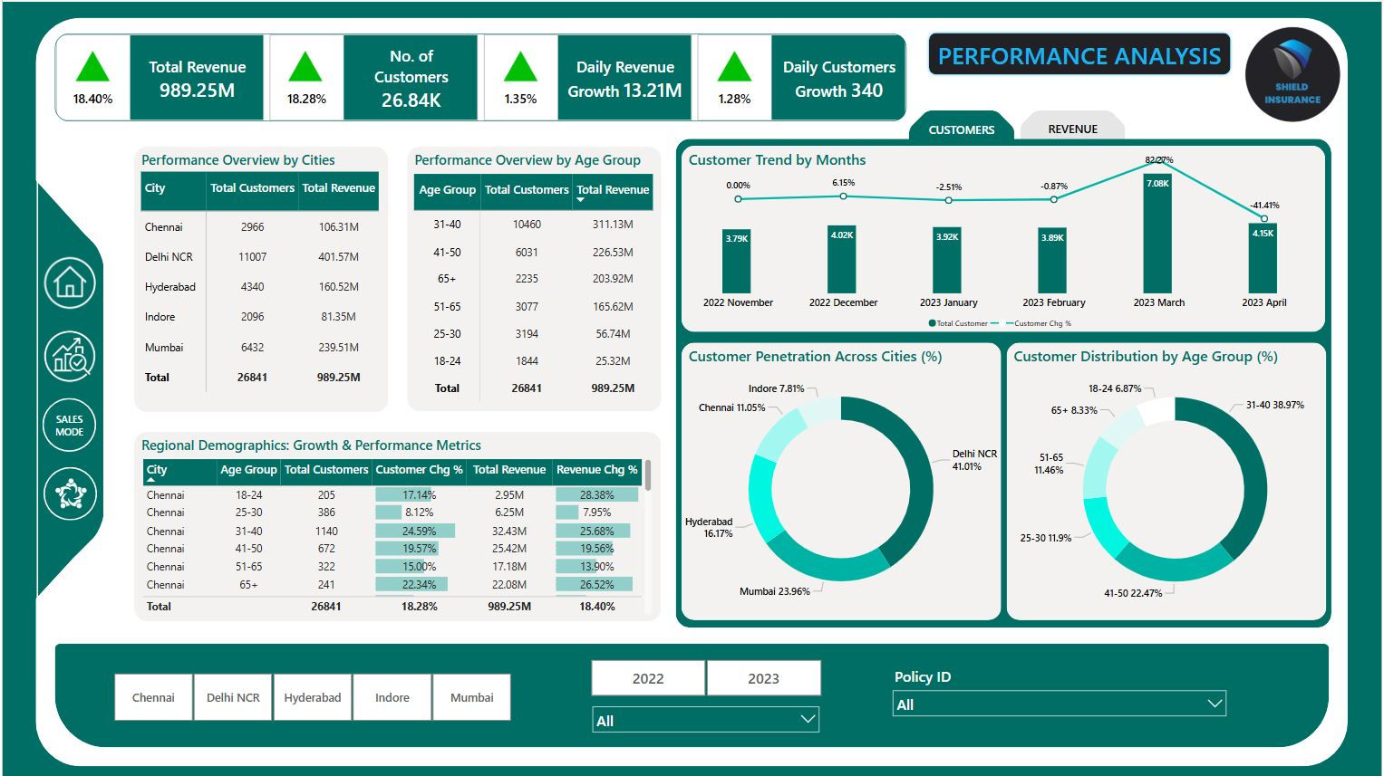
Shield Insurance, I developed a multi-page Power BI dashboard covering customer insights, revenue trends, sales mode performance, and age group analysis. The project focused on identifying key business patterns and delivering actionable recommendations to stakeholders.

Slide 19
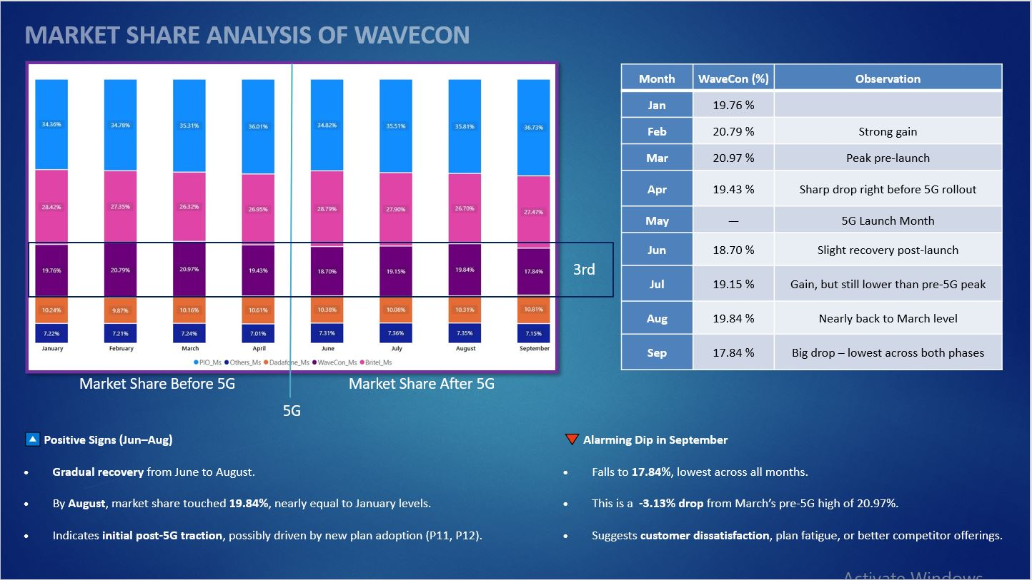
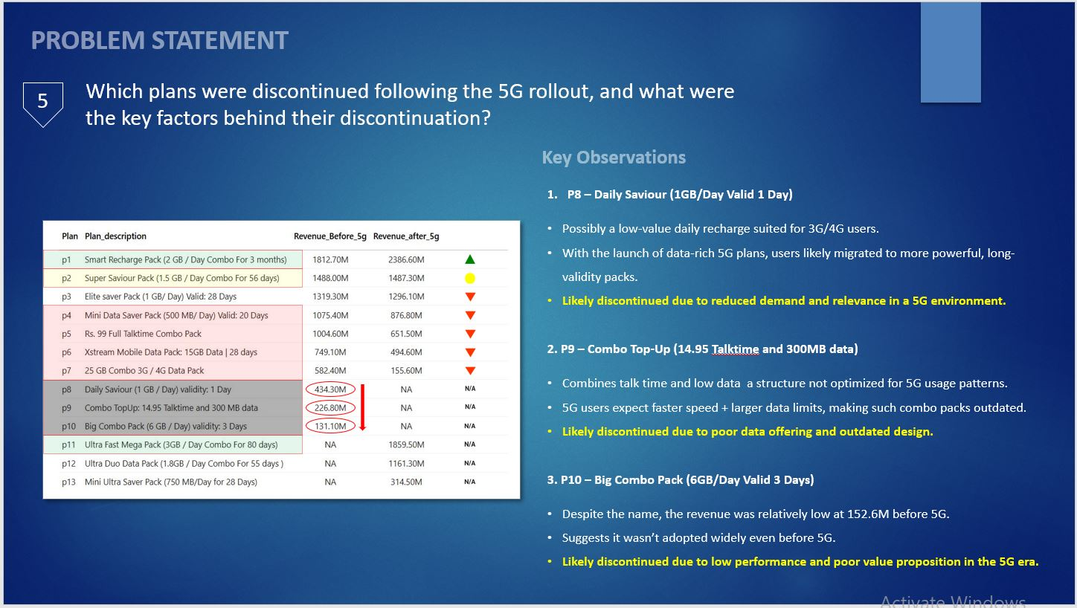
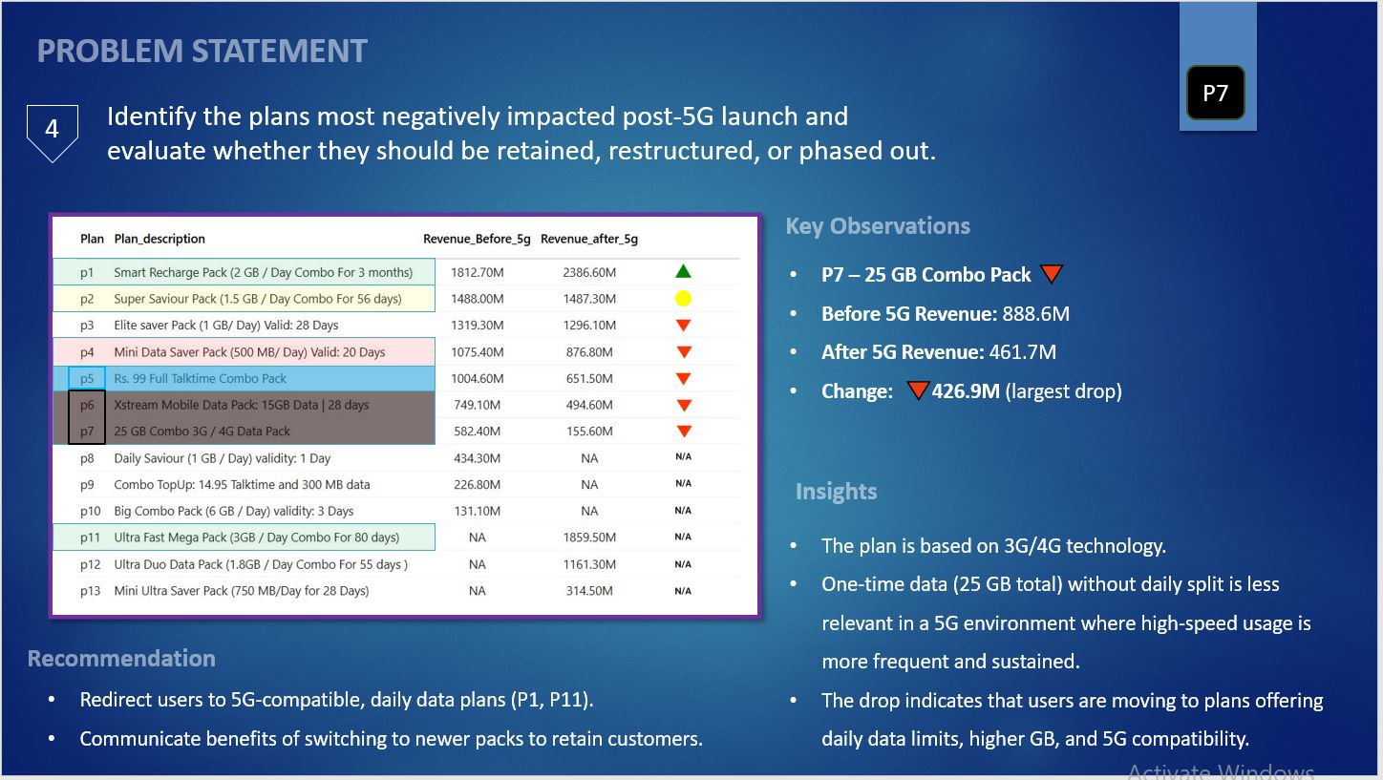
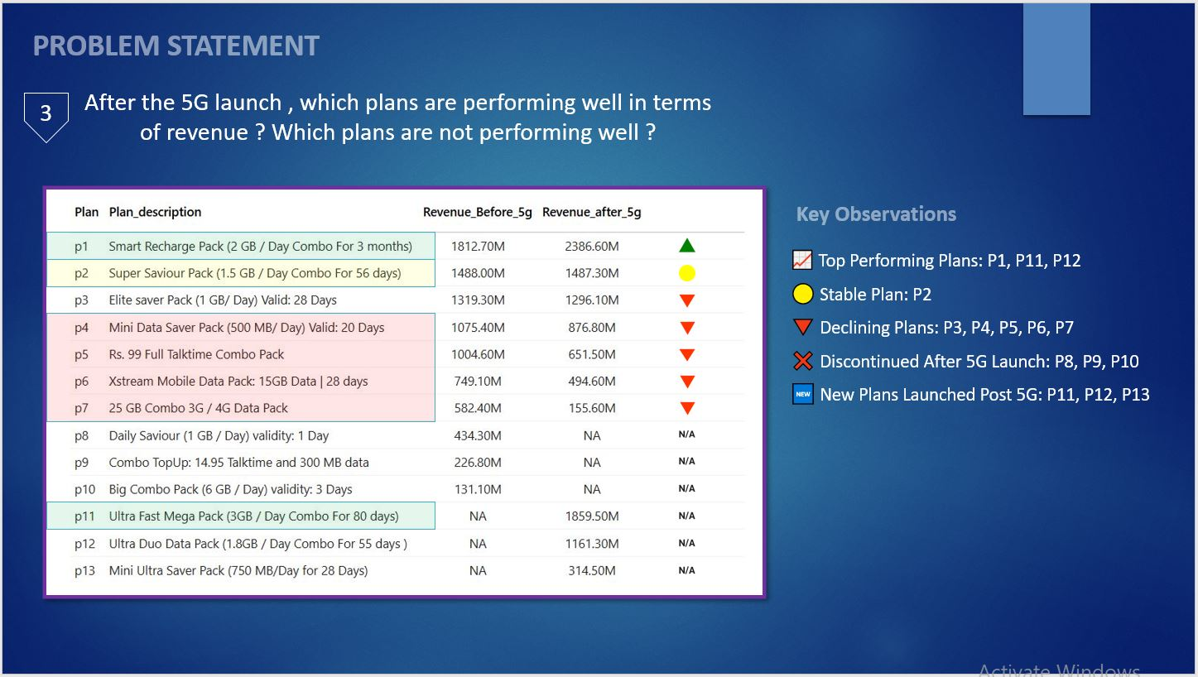
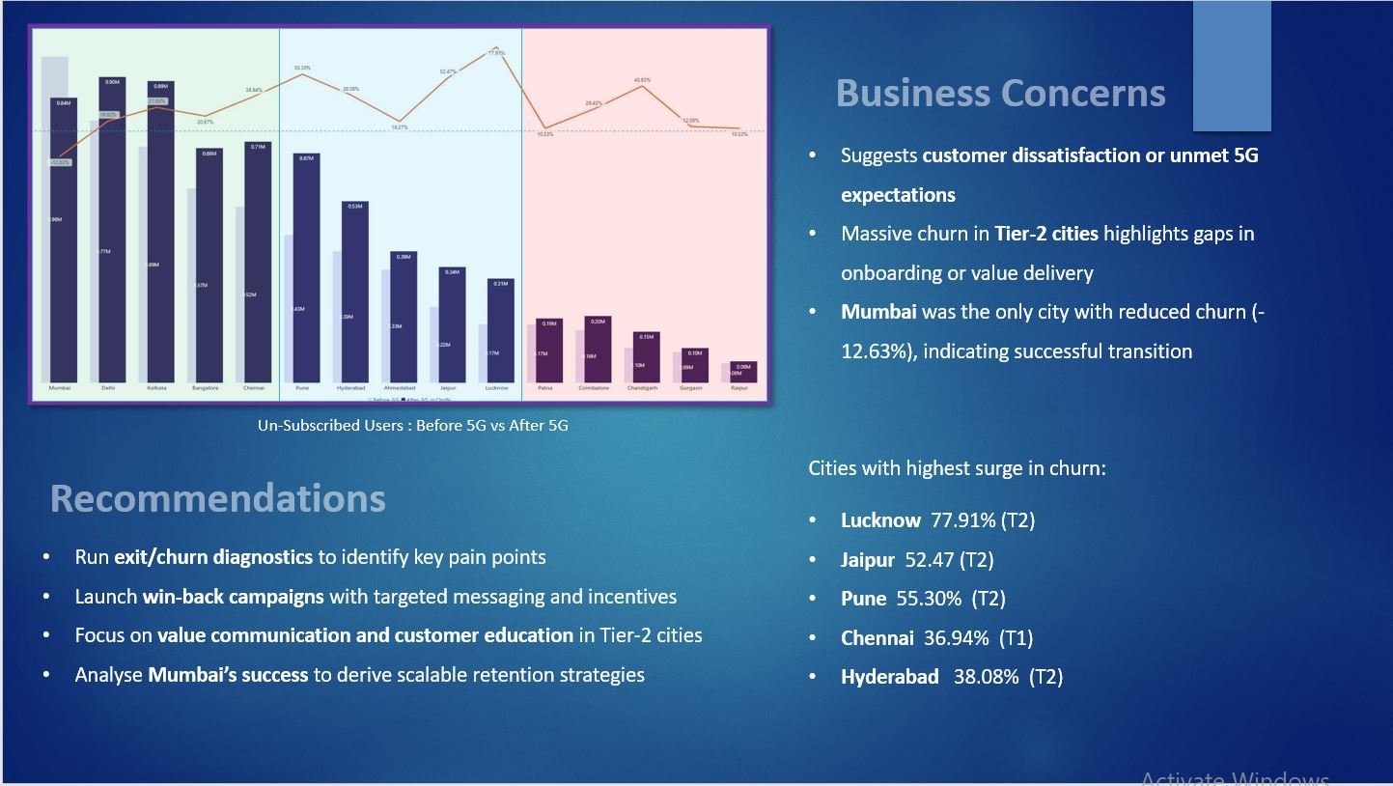
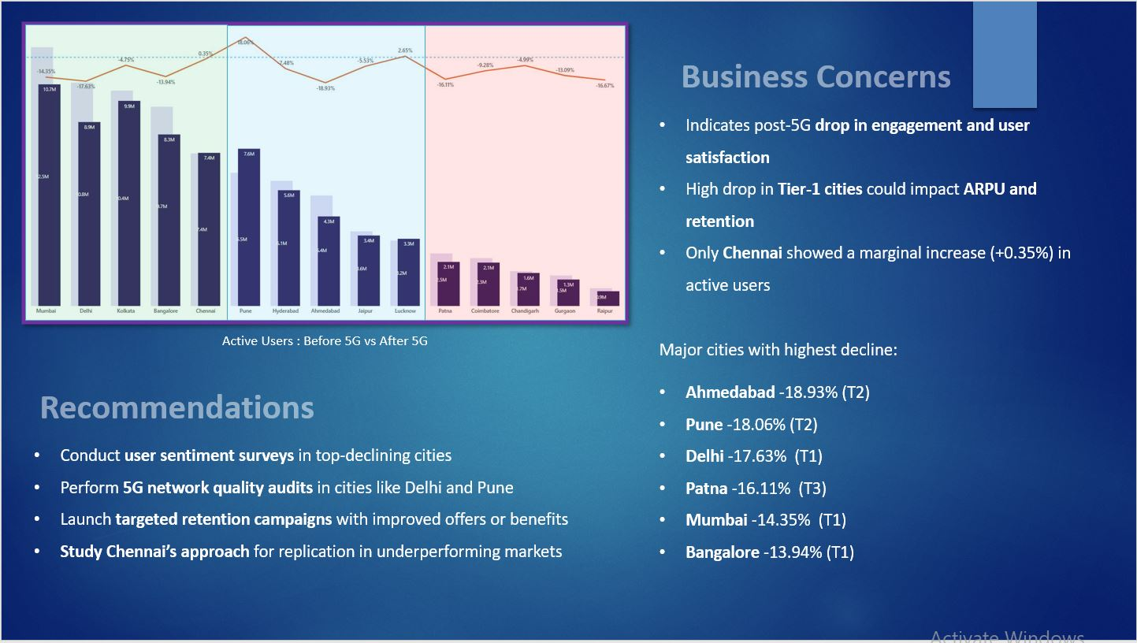
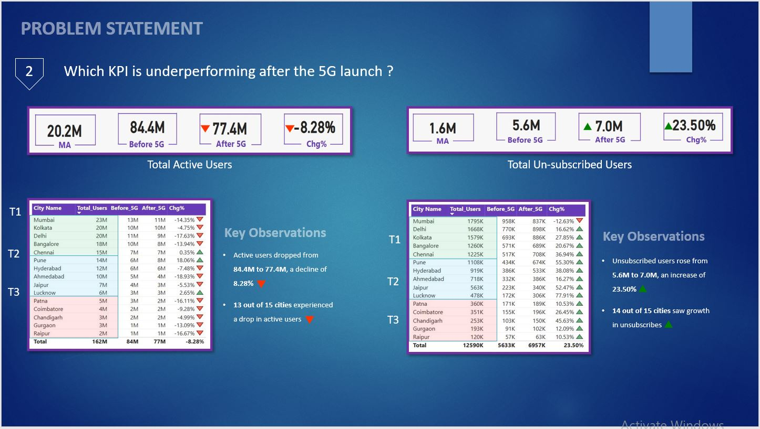
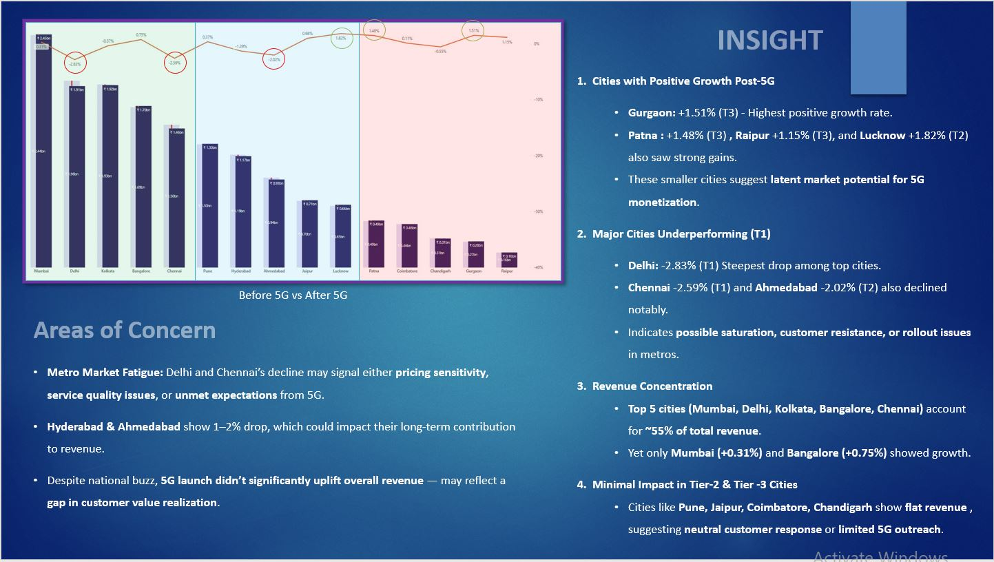
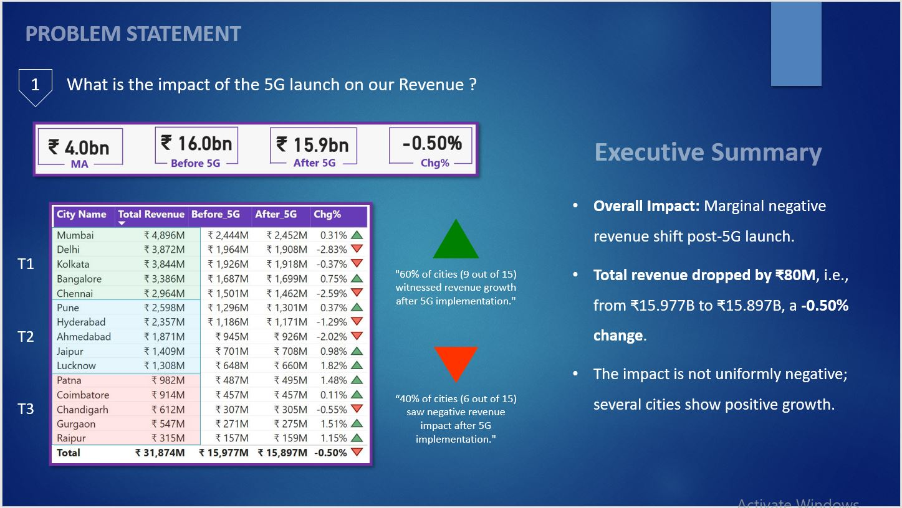
5G Unplugged: Uncovering Insights from Wavecon Telecom’s Data
A data-driven deep dive into performance post-5G rollout
Powered by Power BI & SQL
THANK YOU

Slide 20
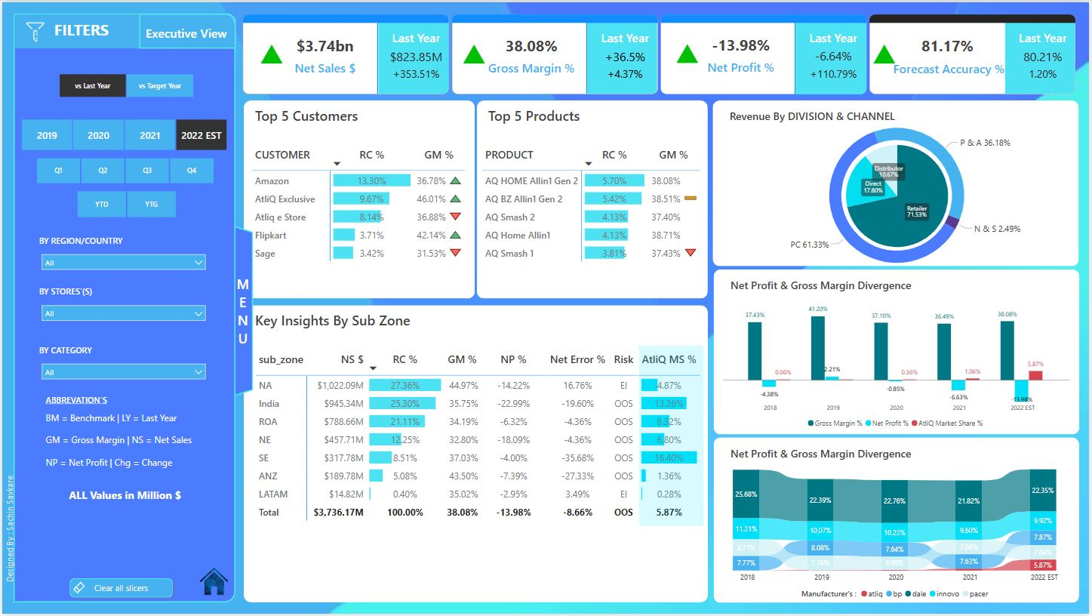
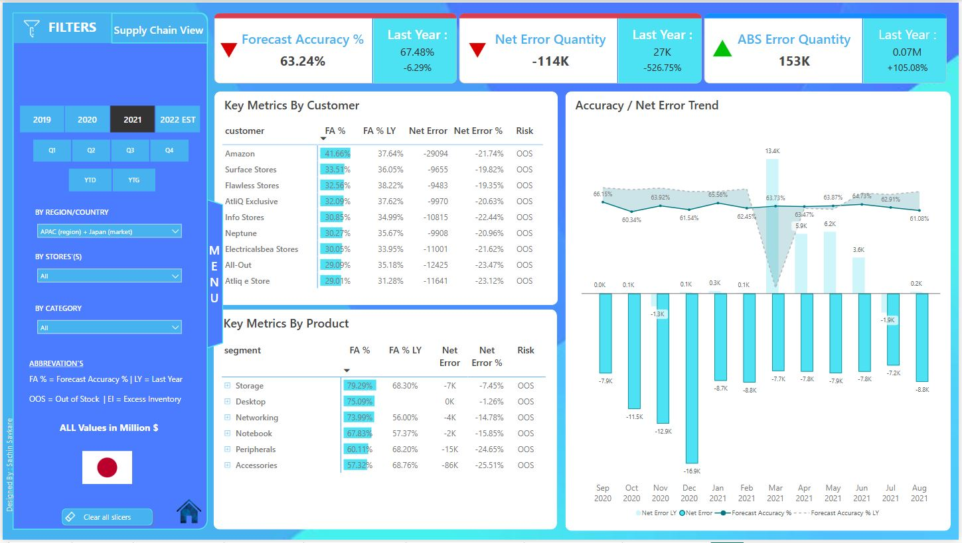
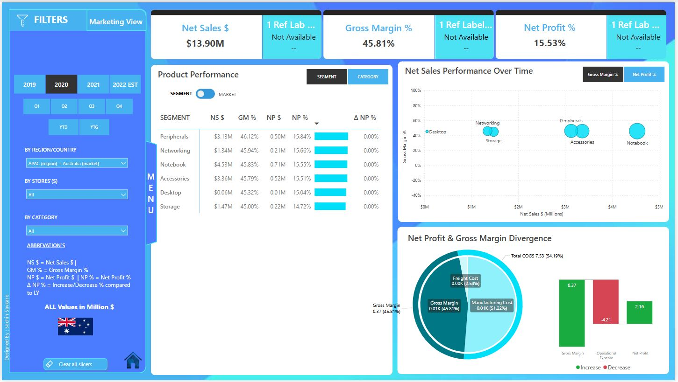
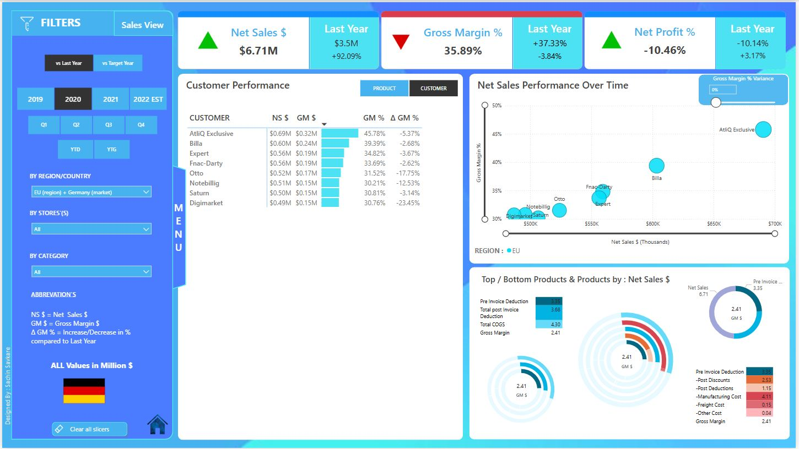
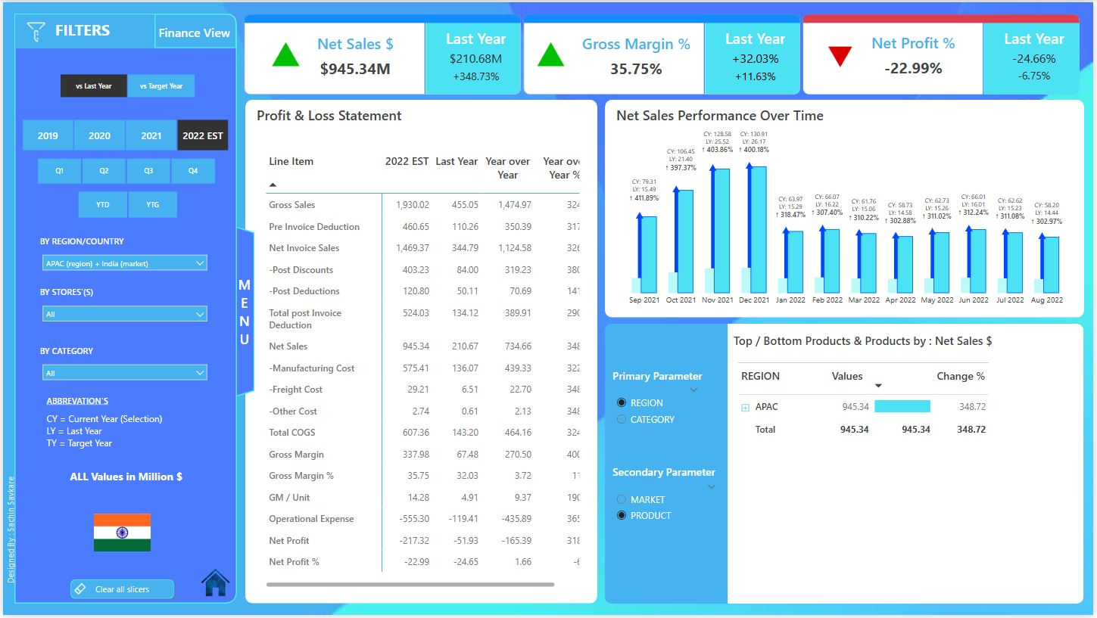
Business Insights 360 | Power BI Dashboard Driving Smarter Decisions Across Finance, Sales, Marketing, Supply Chain & Executive Views

Slide 21
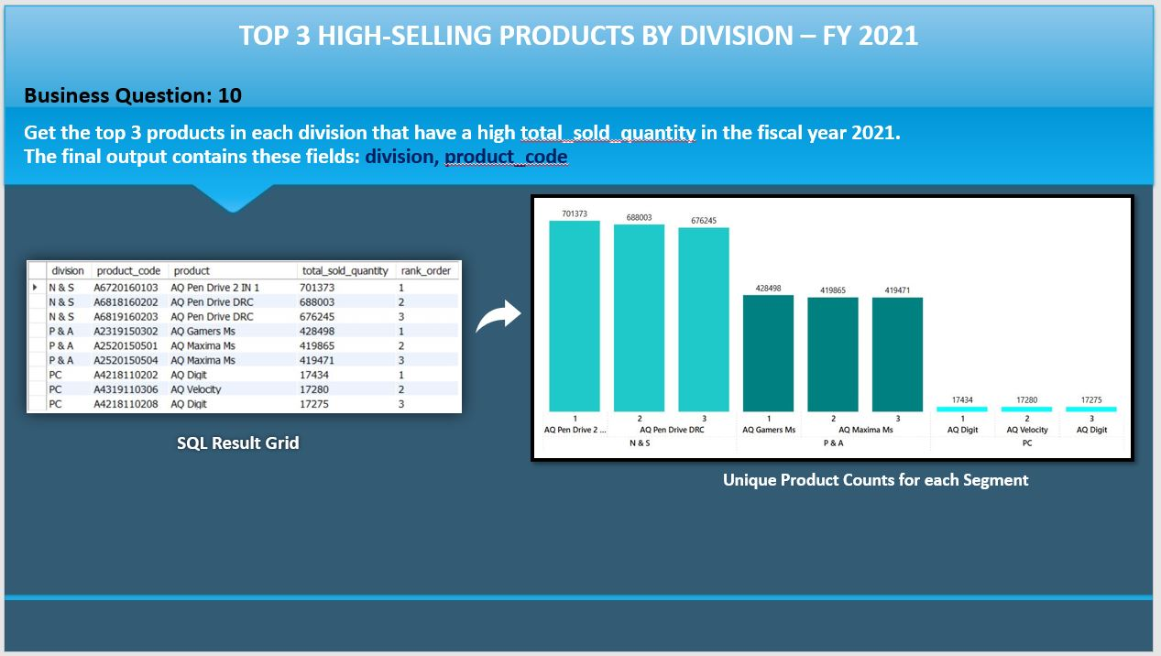
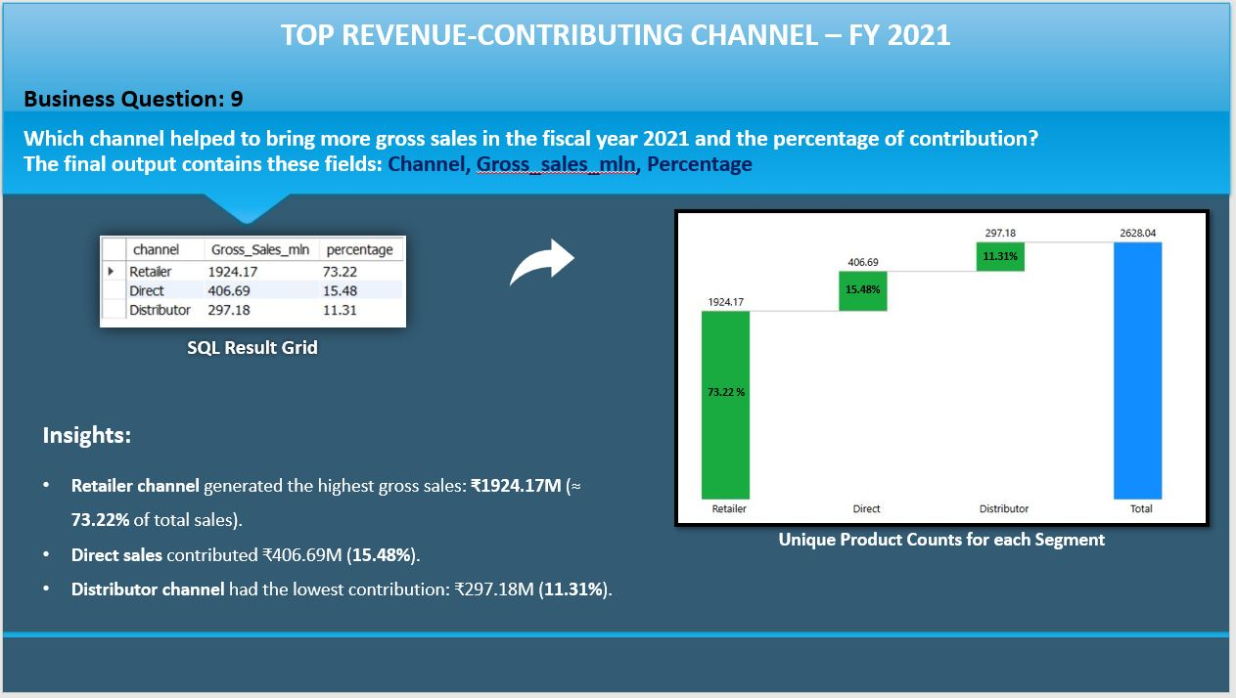
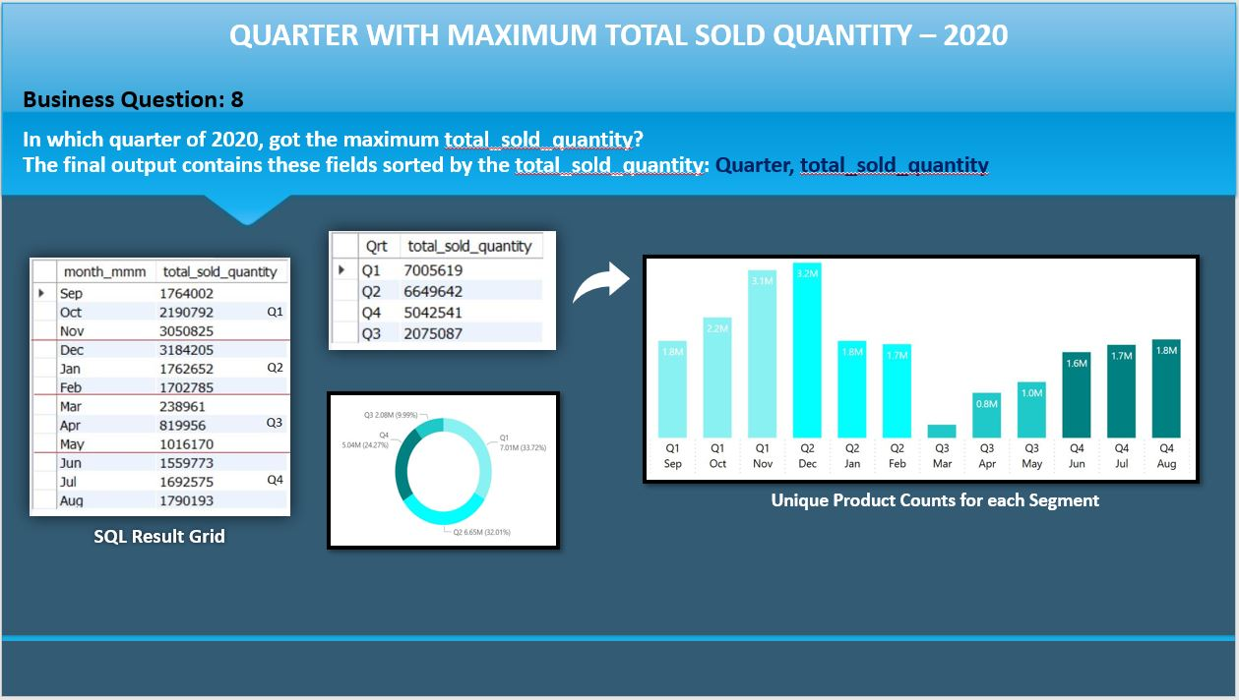
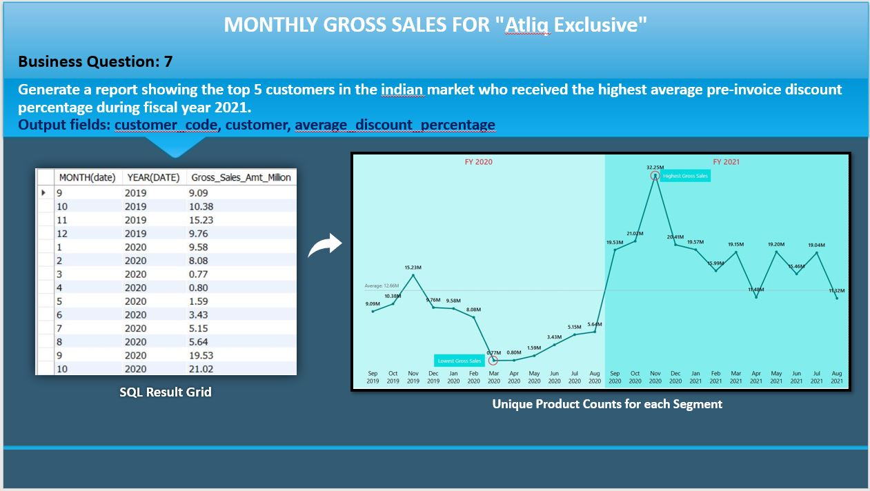
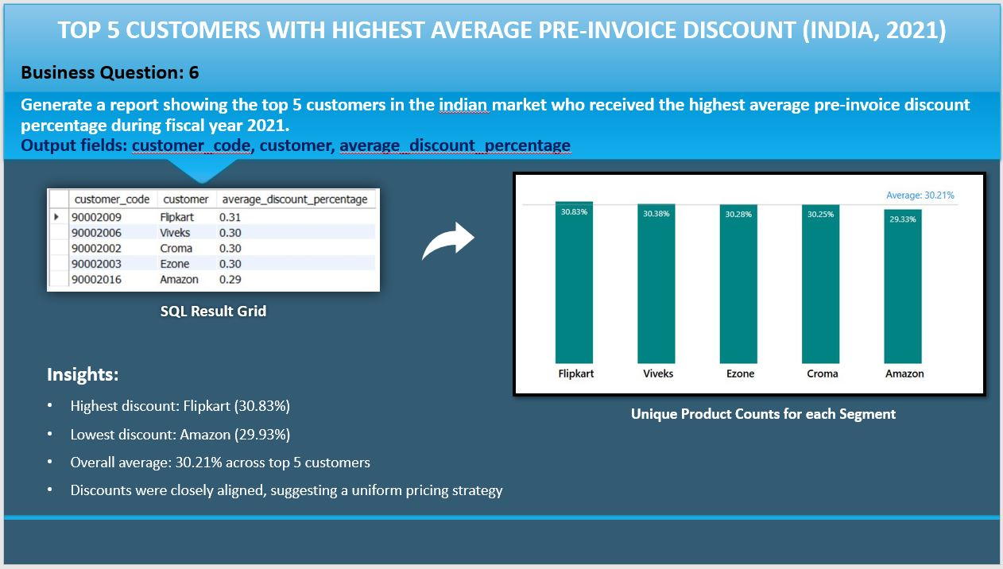
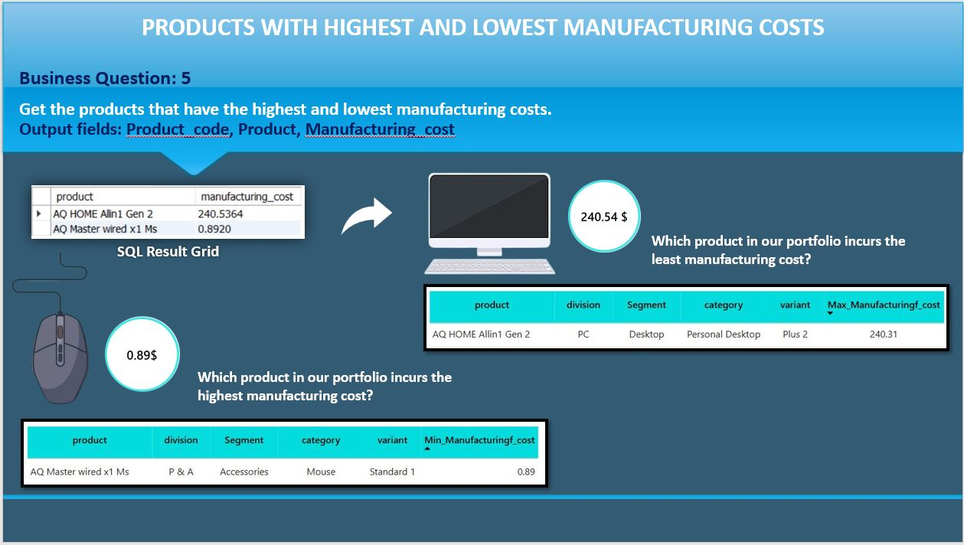
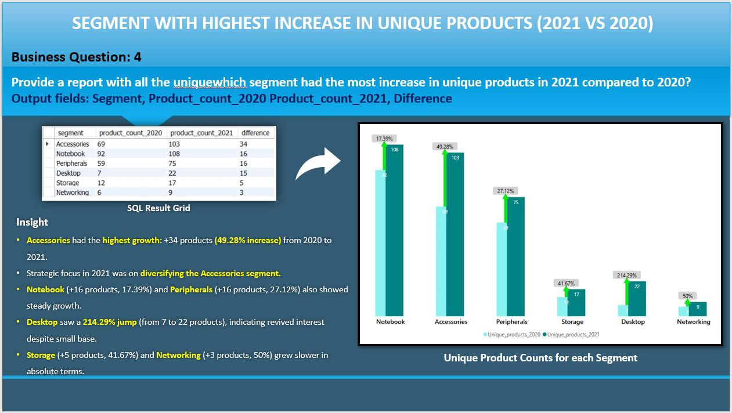
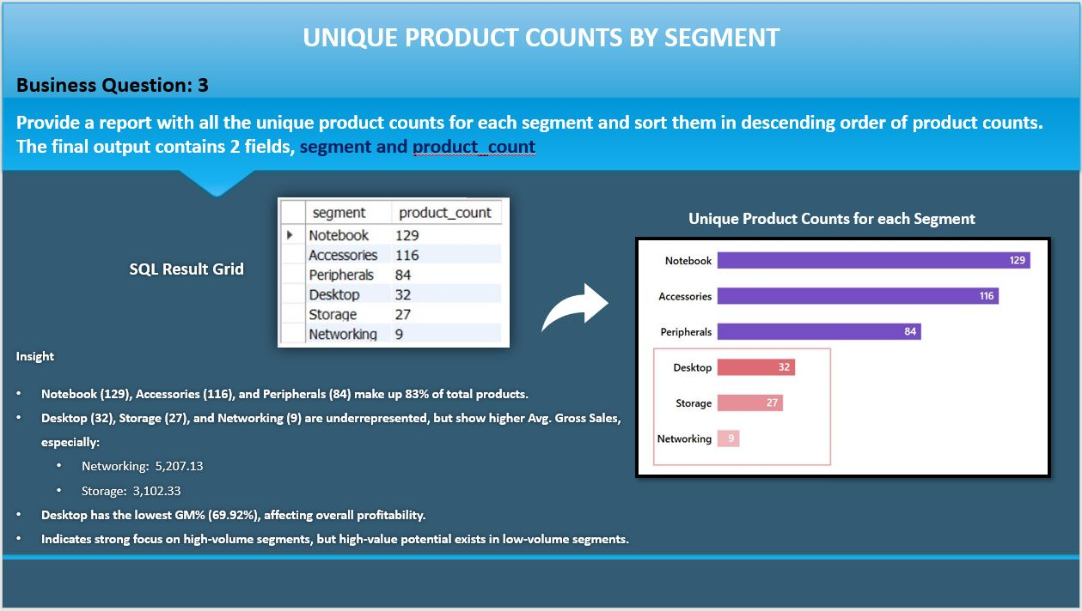
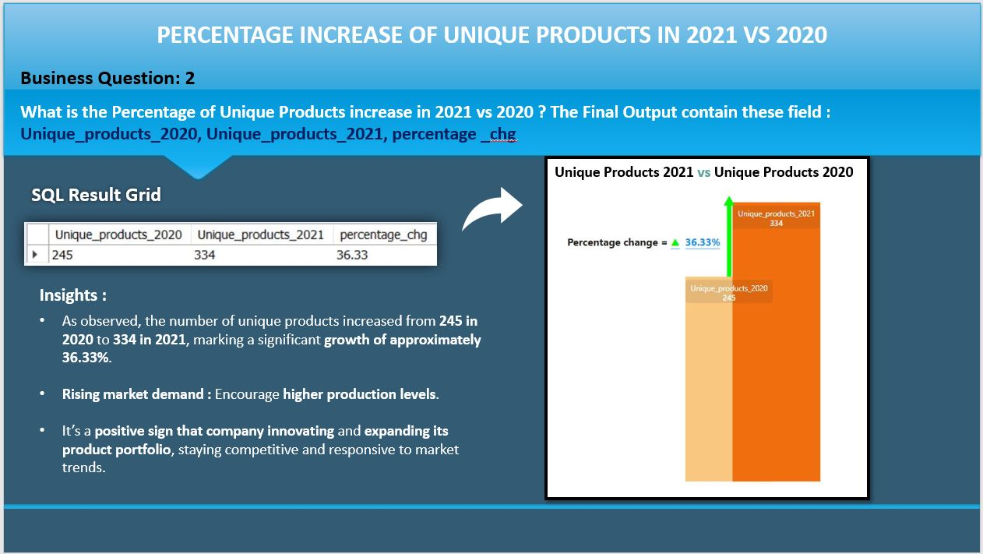
Analysis of 10 Ad-Hoc Requests: SQL Query Results, Strategic Insights, and Data Visualizations for AtliQ Hardware (Consumers Goods)

Slide 22
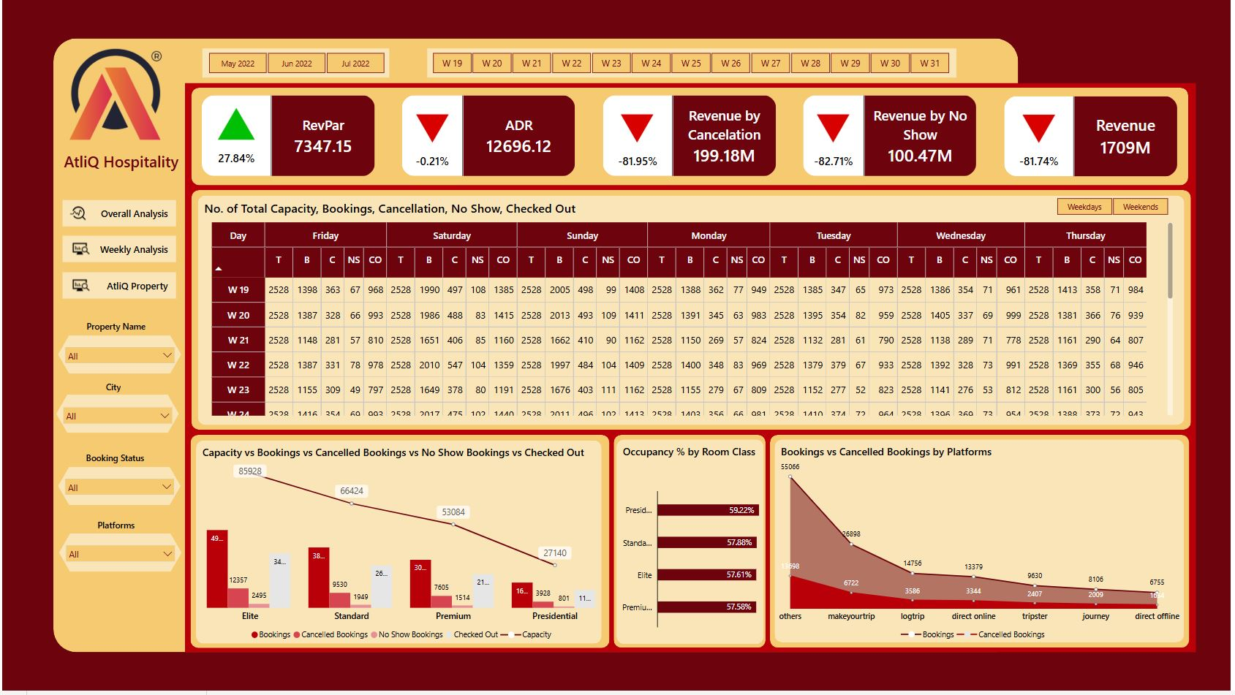
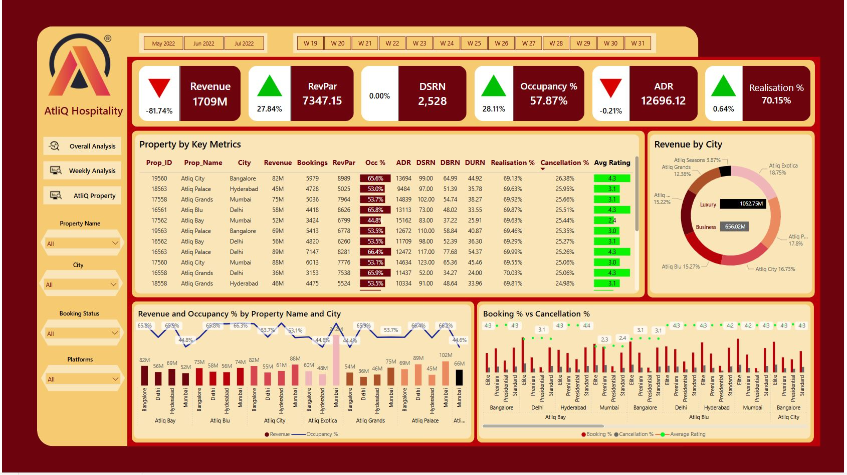
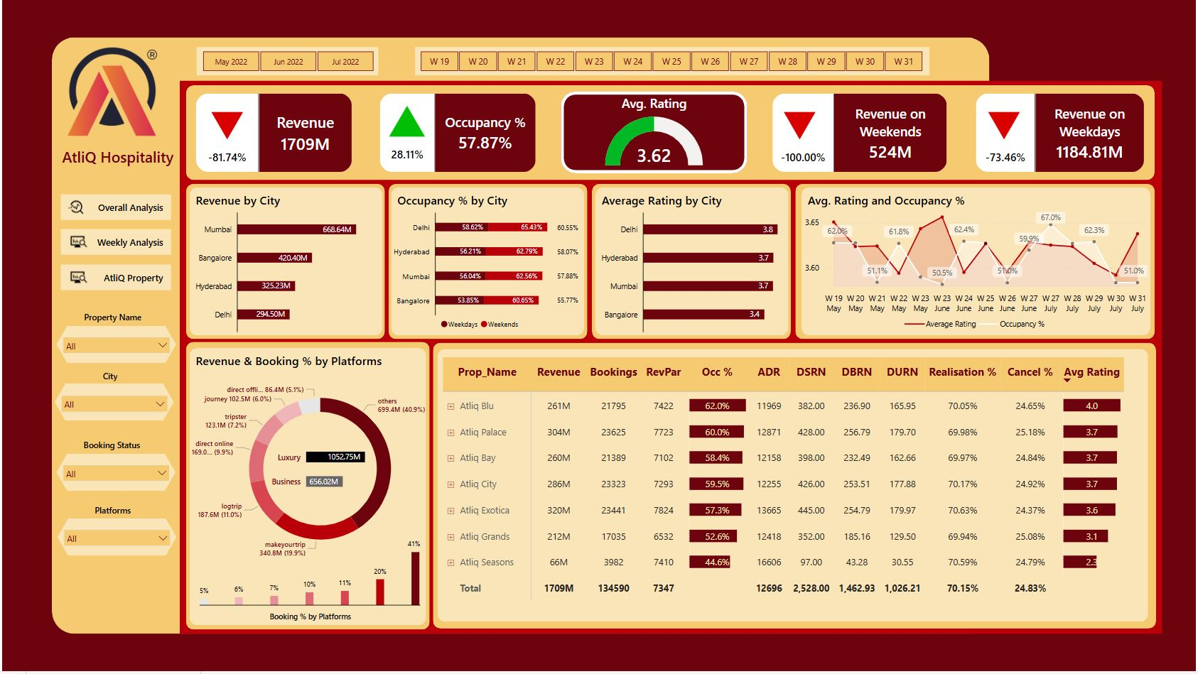
Unlocking Hospitality Growth: Power BI Insights Driving Revenue & Strategy for AtliQ Grands

Slide 23
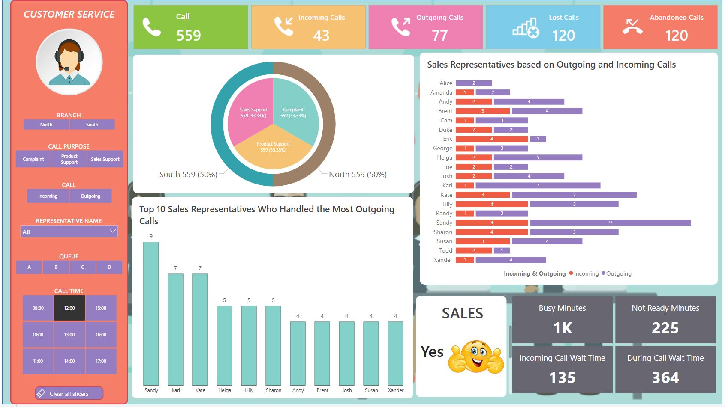
Customer Experience Analytics | Power BI Dashboard for Operational Insights

Slide 24
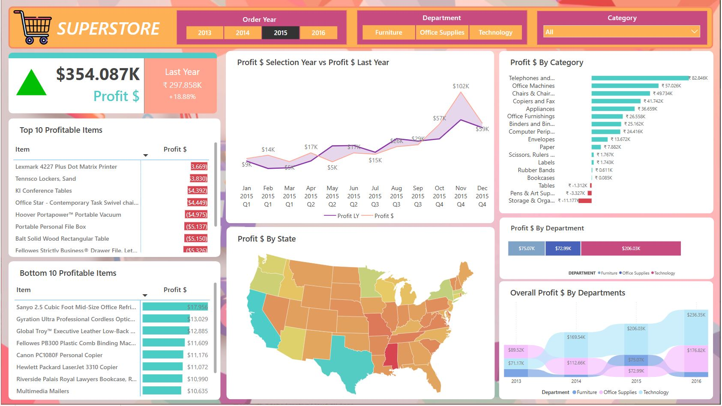
Consumer Goods | Superstore Analysis: Turning Data into Decisions with Power BI

Slide 25
THANK YOU

